Slide 1
Great Sutton Wellness Company CIC- Who and What!
James Duckers
Managing Director

Slide 2
Who are we?
7 GP partners all from Great Sutton Medical Centre
Dr Merriman
Dr McVeigh
Dr McAlavey
Dr Francey
Dr Thorburn
Dr Crofts
Dr Fowler
1 Senior Manager from Great Sutton Medical Centre
James Duckers

Slide 3
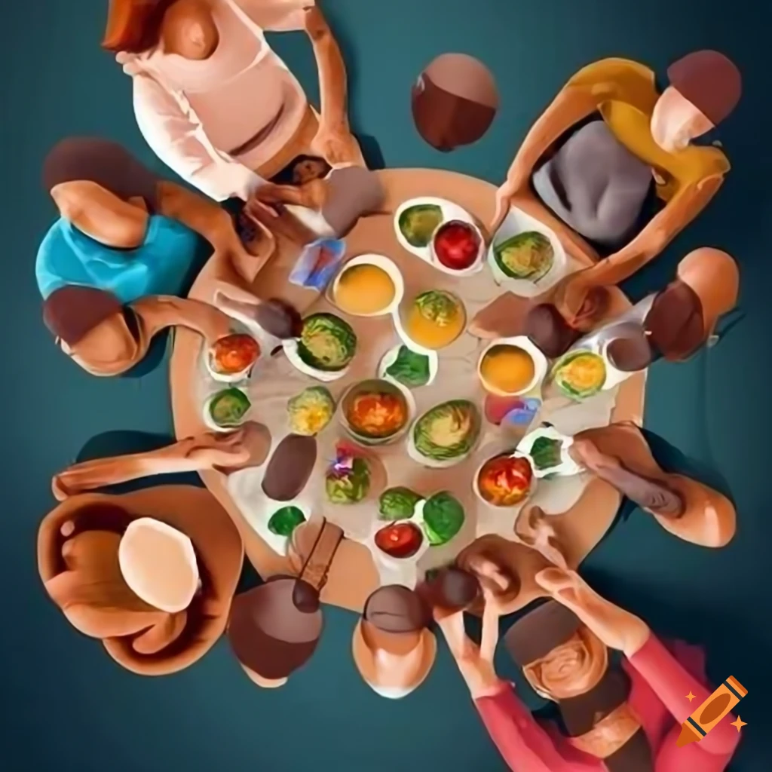
Why have we developed the Wellness Company?
As a group of professionals, we have identified that many of the issues we deal with in our day-to-day work as a GP practice could be reduced with the right preventative support.
Our team wants to use its clinical experience and knowledge if preventative health measures to engage the community in healthy behaviours.
We all have a passion for making a difference within the community and improving the lives that reside within it.

Slide 4
Why a social enterprise?
Great Sutton Wellness Company CIC is a not-for-profit organisation run by individual's whose aim is to give back to it’s community.
As professionals with the aim of community benefit at it’s heart we believed that the most suitable vehicle for running this organisation was one that invests its profits into it’s community.
Our team have all come from public sector roles that have always focussed on helping the community it serves.

Slide 5
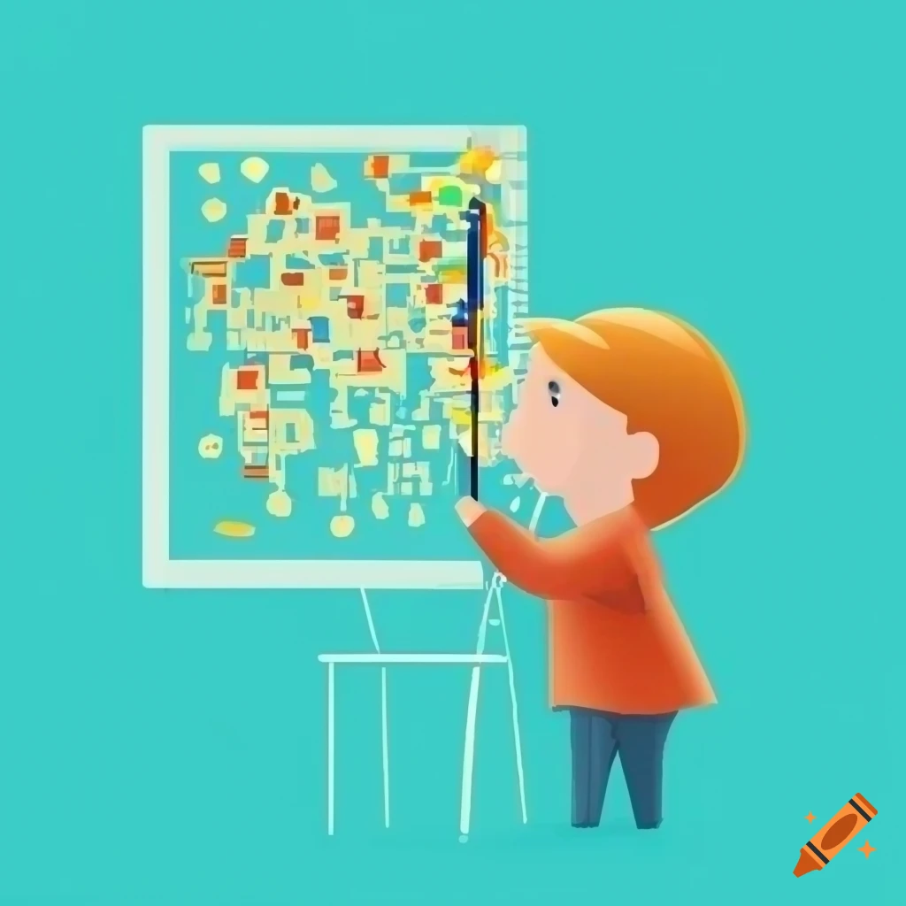
What do we plan to do?
we plan to identify the needs of our community that could be improved by health promotion.
We will look to secure funding to develop these programmes utilising the clinical knowledge and experience within the team.
We will engage the community and deliver key programmes to help improve health and wellbeing
We will work with practice data to monitor improvements and possible changes.
We will develop platforms to share information about healthy opportunities and information
We will work with local organisations to help them access our local communities

Slide 6
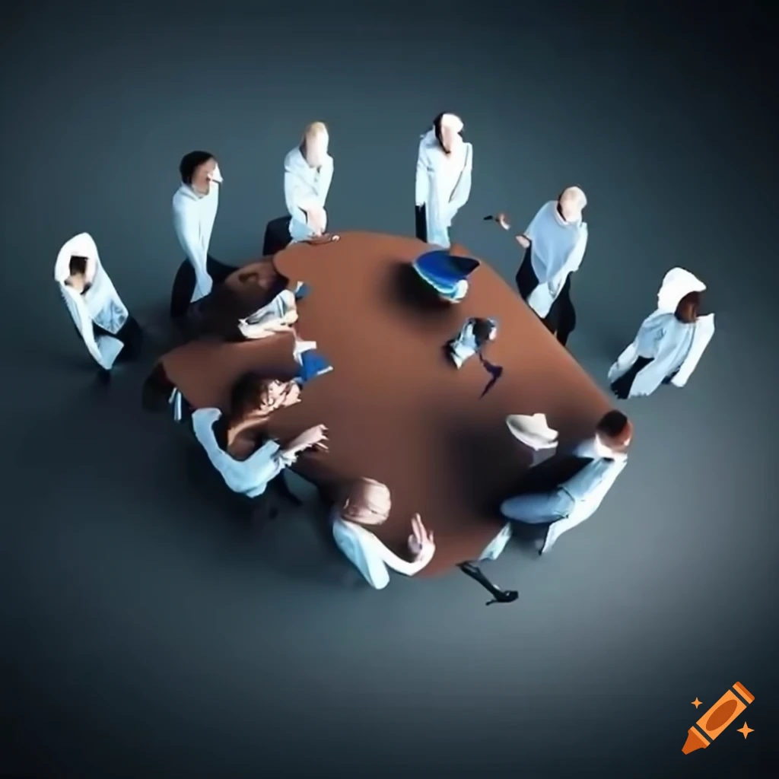
What areas will be our main focus?
As we engage with the community we are expecting to understand more about the community's needs.
At present we are looking at areas of general health promotion which we know will have a large impact on the people within the local community:
Being more active
Opportunities to be more sociable
Healthy eating
Addressing emotional wellbeing

Slide 7
A snapshot

Slide 8
How to see what we are doing?
Follow us on facebook –
https://www.facebook.com/profile.php?id=61560538875581
Email us – gswccic@outlook.com

